Slide 1
NE 591: Advanced Reactor Materials
Fall 2021
Dr. Benjamin Beeler

Slide 2
Last Time
To remove this (U,Mo)Al phase, we can: 1) coat the particles; 2) modify chemistry (such as by adding Si); 3) substitute the Al matrix with another materials; 4) remove the matrix
Fuel fabrication specifications can dramatically affect the microstructure and thus the performance of the fuel – this is more critical for monolithic fuels
The Zr interdiffusion barrier prevents UMo-Al interaction, but creates new interaction layers with a series of phases present
UMo fuel creeps, creating a bulge just inside the edge of the fuel
Decomposed regions can accelerate grain refinement and swelling and can be reduced through chemical homogenization and annealing
Al is ideally suited for the research reactor environment with its excellent corrosion and swelling resistance at applicable temperatures
Microstructural modeling is attempting to describe the variety of governing phenomena in UMo fuel

Slide 3
Quantum Espresso Q&A
What do you got?

Slide 4
advanced cladding

Slide 5
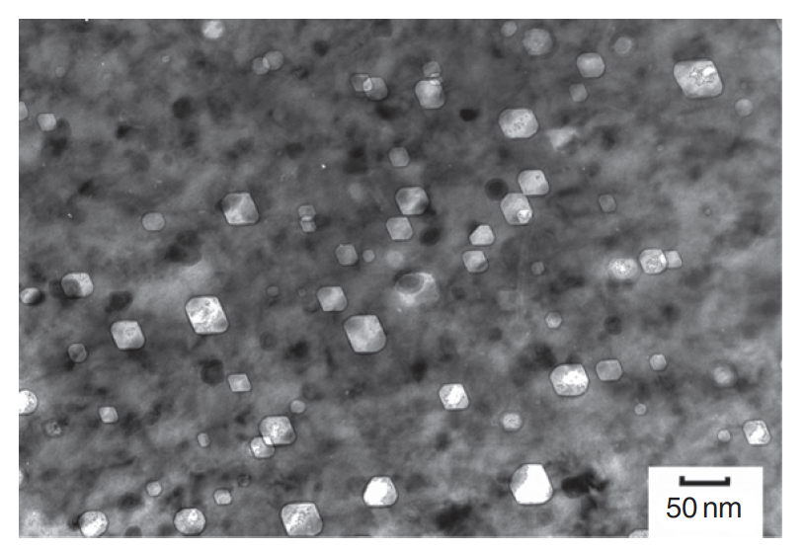
The need for advanced cladding
Austenitic stainless steels are widely used as structural components in nuclear service
At high dose, the microstructure develops a high concentration of voids, leading to dramatic swelling
Swelling of cladding in FFTF and BN-600
Void swelling in 304SS

Slide 6
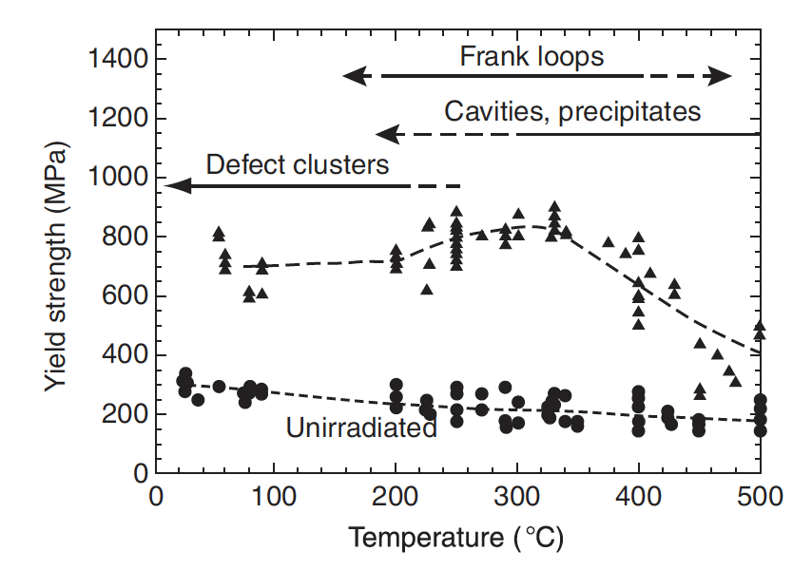
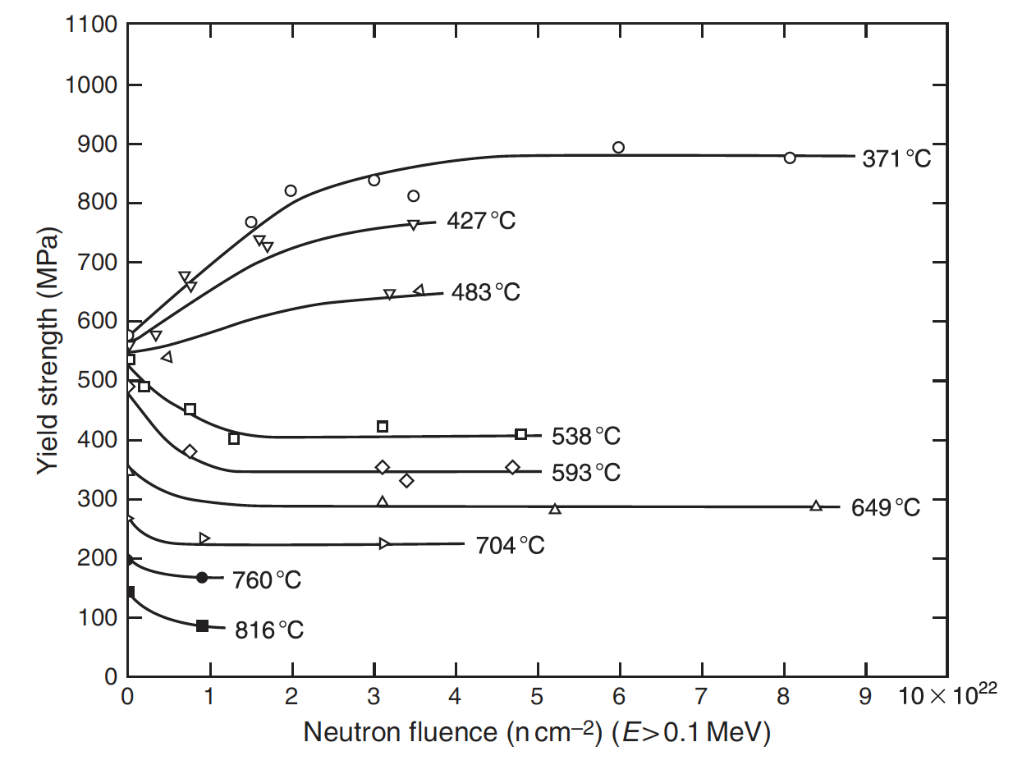
The need for advanced cladding
In addition to high fluence, high temperature contributes to void swelling
SS significantly weakens with increasing temperature
Thus, their applicability is limited in advanced reactor systems

Slide 7
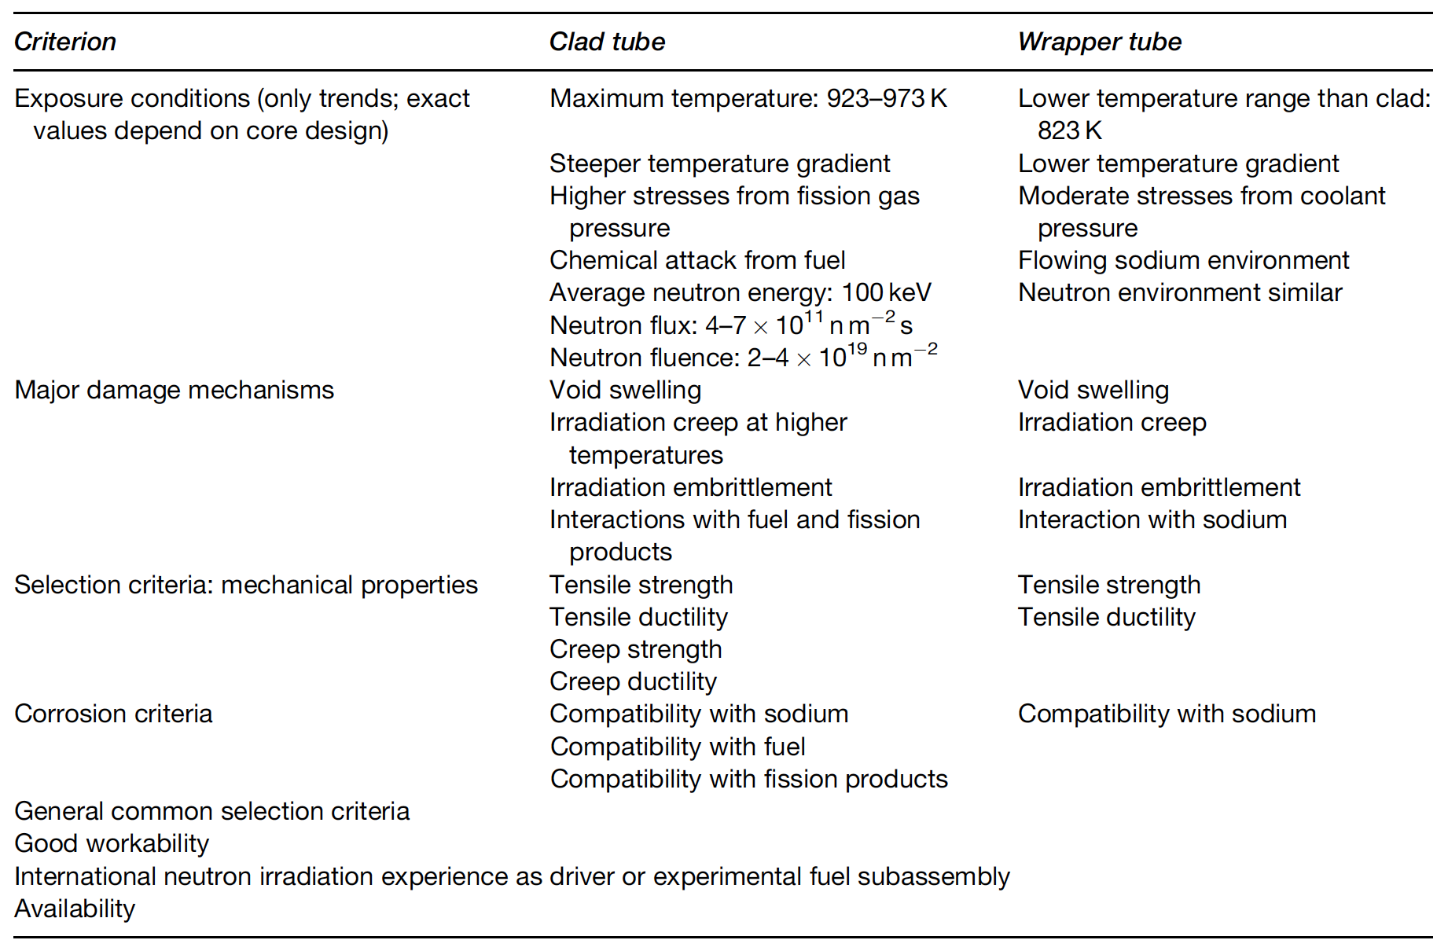
Fast Reactor Conditions
The structural components experience a different environment in advanced fast reactors than those in commercial LWRs
Key phenomena include void swelling, irradiation growth, irradiation hardening, irradiation creep, irradiation, and helium embrittlement

Slide 8
Ferritic-Martensitic Steels
The advanced ferritic and ferritic–martensitic steels of current interest have evolved from creep-resistant ferritic steels
Subsequent developments through different levels of Cr and Mo have led to the current ferritic and ferritic–martensitic steels: 9–12% Cr–Mo steels
F-M steels have advantageous mechanical properties, are relatively cheap, and control of their microstructure can be performed with heat treatments
F-M steels generally have worse high T mechanical properties than austenitic steels, especially creep life and irradiation creep resistance

Slide 9
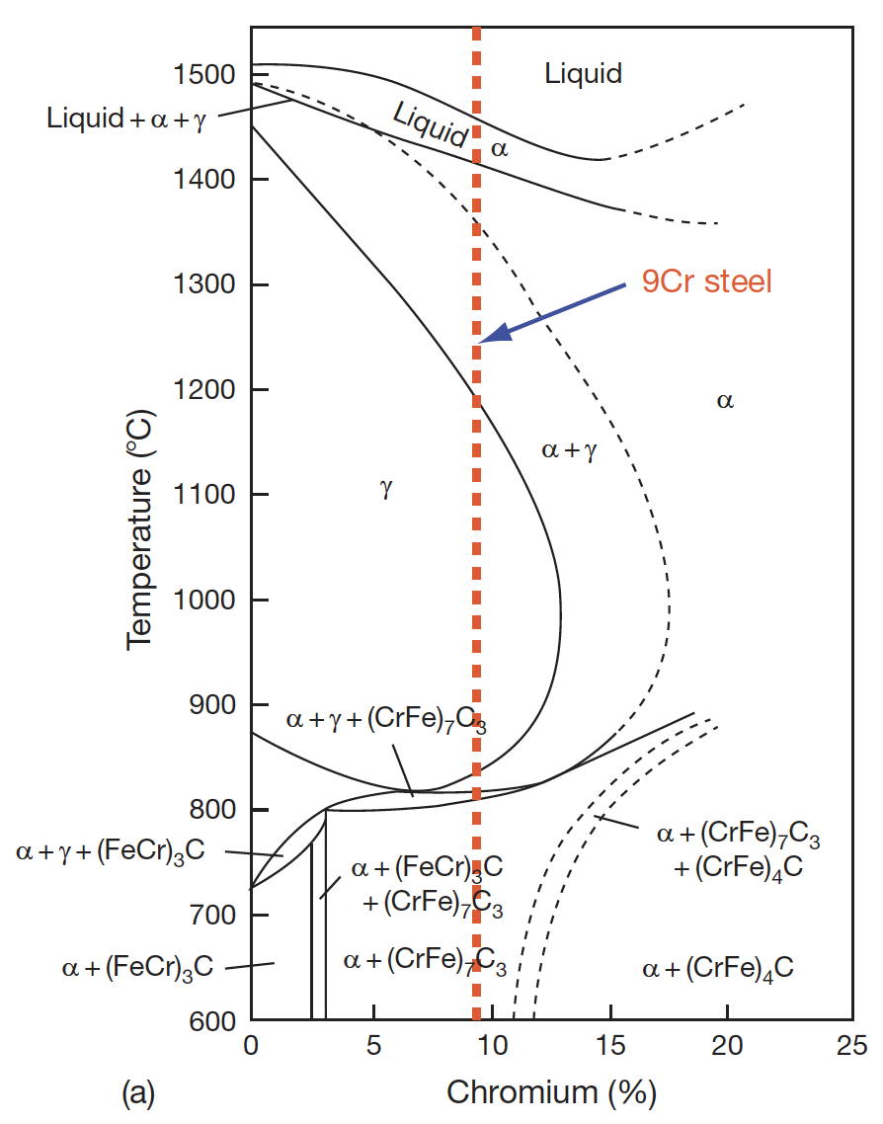
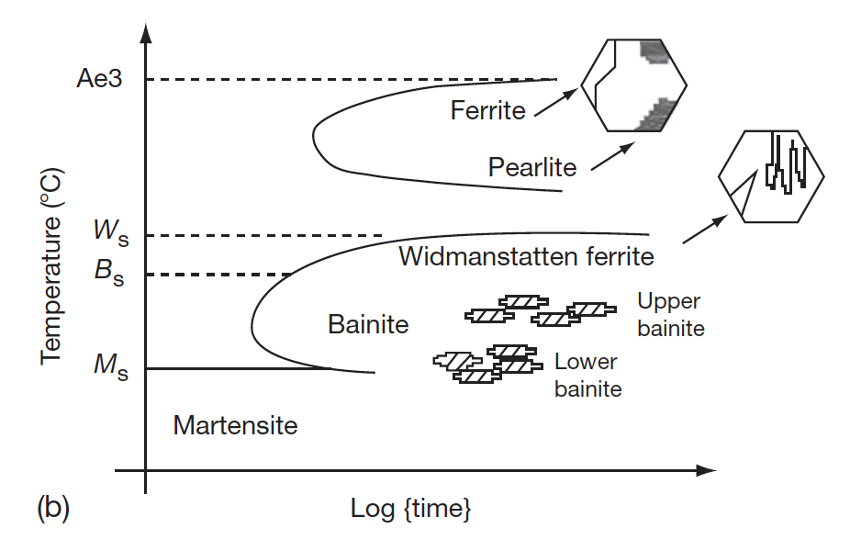
Ferritic-Martensitic Steels
The ability to retain ferrite (bcc Fe) is dependent upon the alloying elements
In addition to Cr and Mo, the amount of Si, V, and C affect the phase boundaries
Accordingly, the 9CrMo family of steels can either be martensitic (9Cr–1MoVNb (T91)), ferritic (12Cr–1MoVW (HT9)) or ferritic–martensitic (9Cr–2Mo–V–Nb (EM12)) steel
TTT diagram of austenite
Pseudo-binary phase diagram with Cr equivalent

Slide 10
Composition Effects
The developed of 9Cr-Mo steels was initially focused on oxidation resistance and creep strength
The optimized initial alloy composition considered was 9Cr, 2Mo, 1W, 0.5Si, with C, B, V, Nb, and Ta in small amounts
A reduction in Cr content lowers the oxidation resistance
Higher Cr content has two effects, 1) it increases the hardenability leading to the formation of martensite, and 2) promotes the formation of δ-ferrite, reducing the toughness
If the W+Mo concentration is kept <3%, creep strength will reduce, while higher amount promotes the formation of δ-ferrite and brittle Fe2Mo Laves phase

Slide 11
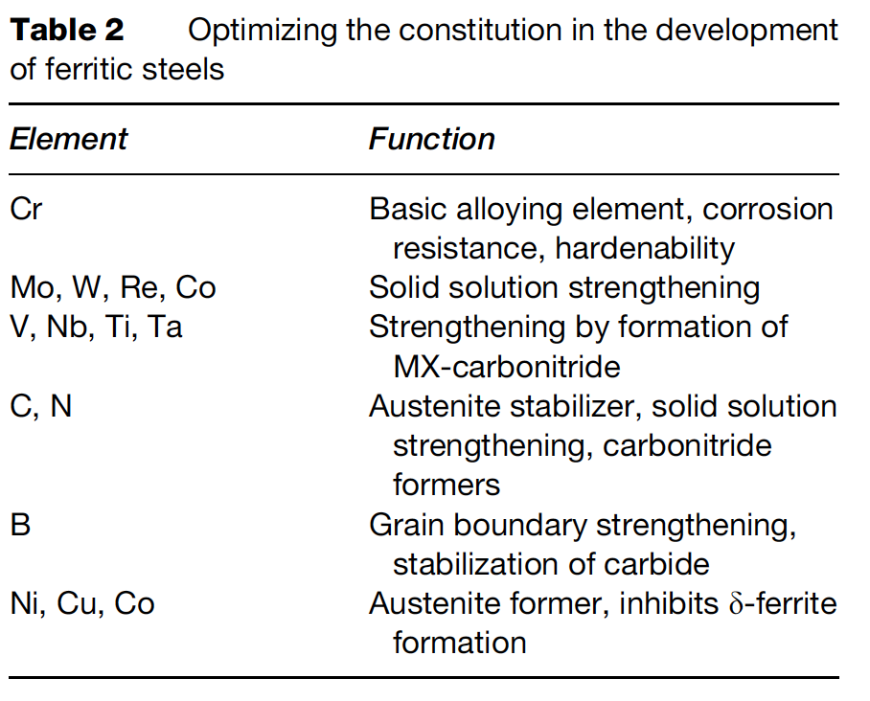
Composition Optimization
The addition or replacement of Mo with W and B increases the stability of M23C6
Lower Ni content introduces δ-ferrite, while its increase reduces creep strength
Lower Si reduces oxidation resistance, while higher Si content leads to agglomeration of carbides
The composition of all other elements can be optimized, based on structure–property correlation studies

Slide 12
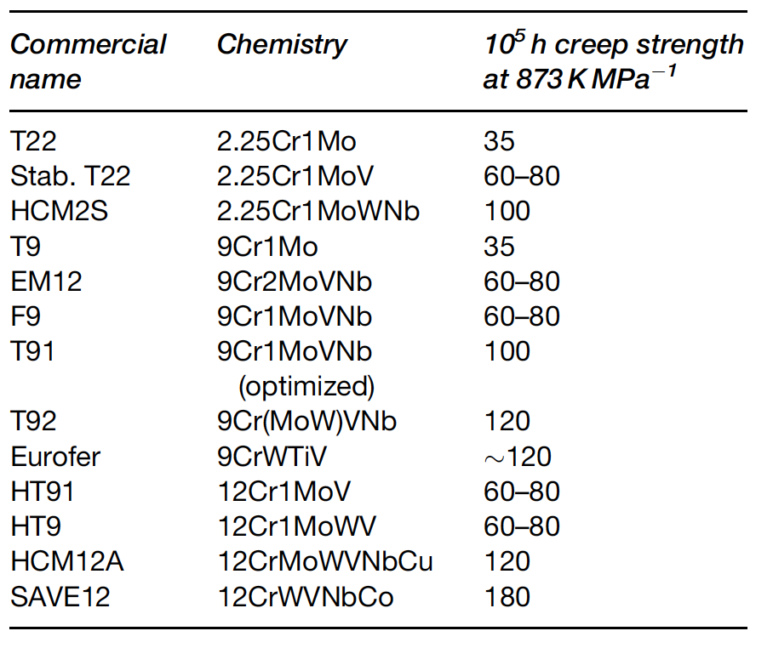
Composition Optimization
The development of high creep-rupture strength steels is based on optimizing the composition, δ-ferrite content, increasing the stability of the martensite, dislocation structure, and maximizing the solid solution and precipitation hardening
Based upon this property tailoring, a large number of alloys have been developed over the last 75 years

Slide 13
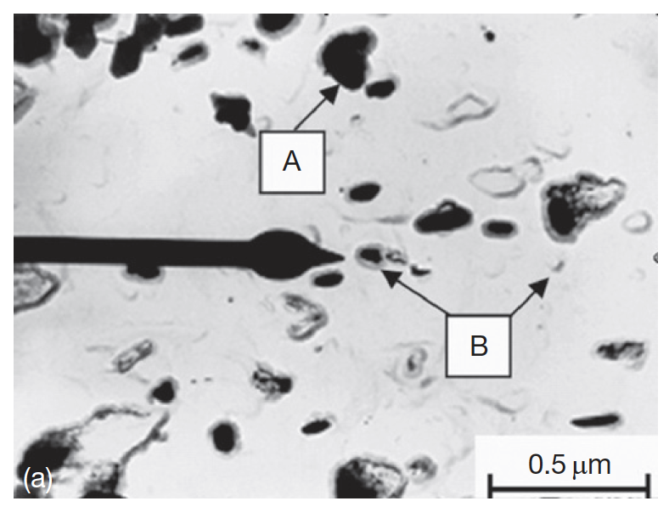
Microstructure
The microstructure of the steels consists of martensite laths containing dislocations and coarse M23C6 particles located at prior austenite and ferrite grain boundaries
Finer carbide precipitates are found within the laths and at the lath/subgrain boundaries
M2X precipitates rich in Cr also form (CrMoWV)2CN

Slide 14
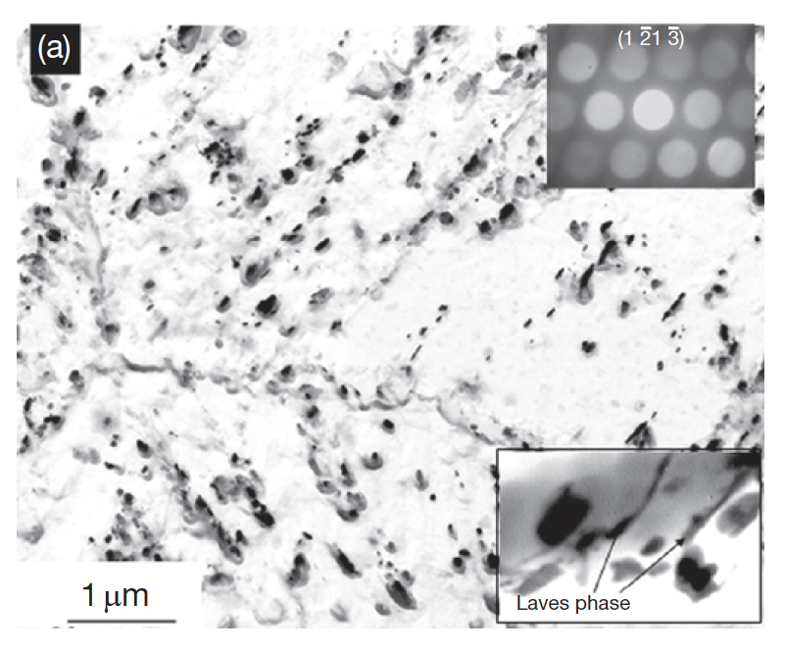
Microstructure
In reactor, this microstructure will change, with the M2X precipitates being replaced by MX intermetallic and Laves phases
There are three types of processes with respect to evolution of secondary phases: irradiation-induced precipitation, irradiation-enhanced transformations, and the irradiation modified phases
The evolution of these phases depends on the composition and structure of the steel and the irradiation parameters like the temperature and fluence

Slide 15
Void Swelling Resistance
Ferritic steels were experimentally observed to exhibit superior radiation resistance compared to austenitic steels
This is largely based on their low swelling behavior
The 9Cr–1Mo steel, modified 9Cr–1Mo (Grade 91), 9Cr–2Mo, and 12Cr–1MoVW (HT9) have low swelling rates at doses as high as 200 dpa
The threshold dose for swelling in ferritic steels is as high as nearly 200 dpa in contrast to 80 dpa for the present generation austenitic stainless steel
HT9 shows 1% swelling at 693 K for 200 dpa

Slide 16
Void Swelling
Void swelling depends crucially on the structure of the matrix lattice, in which irradiation produces the excess defects
There are several reasons why the swelling resistance in ferritic steels is lower than austenitic steels
First, the relaxation volume for interstitials is large in ferrite than in austenite
Thus, for a given interstitial, the strain field is larger in ferrite
This has the impact of more strongly repelling other interstitials, and more strongly attracting vacancies
Second, the migration barrier of vacancies in ferrite is much lower than in austenite (0.55 eV to 1.4 eV)

Slide 17
Void Swelling
Since vacancies are more mobile in ferrite, recombination is more likely with the dispersed isolated interstitials
Additionally, excess vacancies can be trapped at carbide particles
The C-vacancy binding energy in ferrite is twice that in austenite
Finally, the way dislocations and solutes interact in ferrite makes them strong sinks
Given that solutes are oversized substitutionals or interstitials and have a high binding energy with dislocations (often the case), “atmospheres” of solutes can form around dislocations, which are effective sinks for vacancies
These fundamental differences in the behavior of solutes and point defects make ferritic steel superior to austenitic steels, with respect to void swelling

Slide 18
Irradiation Hardening
Microstructure changes due to irradiation harden the steel
High amounts of carbon in 12% Cr steels leads to a large amount of precipitation, up to twice as much as 9% Cr steels
This high carbon content is needed to use steels as martensite
Both the steels have mainly M23C6 carbides with a small fraction of monocarbides
This high concentration of precipitates can eventually lead to brittle failure
The critical stress to propagate a crack is inversely proportional to the crack length, and crack length at initiation is equal to the diameter of the carbide precipitate, then fracture stress also decreases with increasing precipitate size

Slide 19
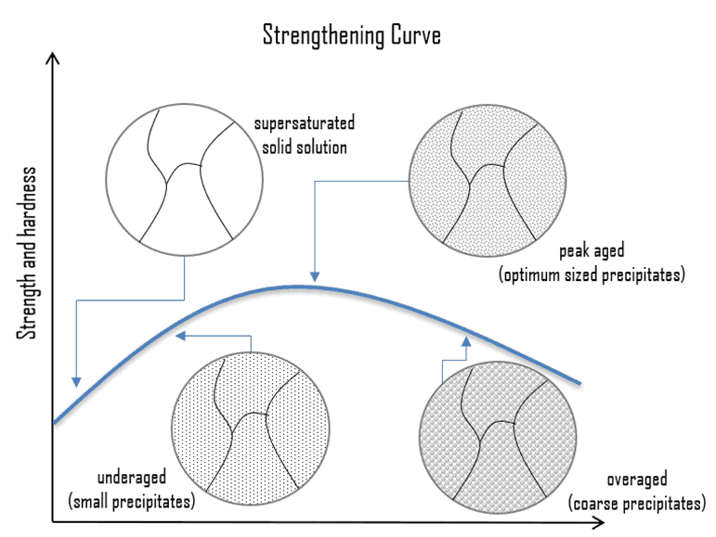
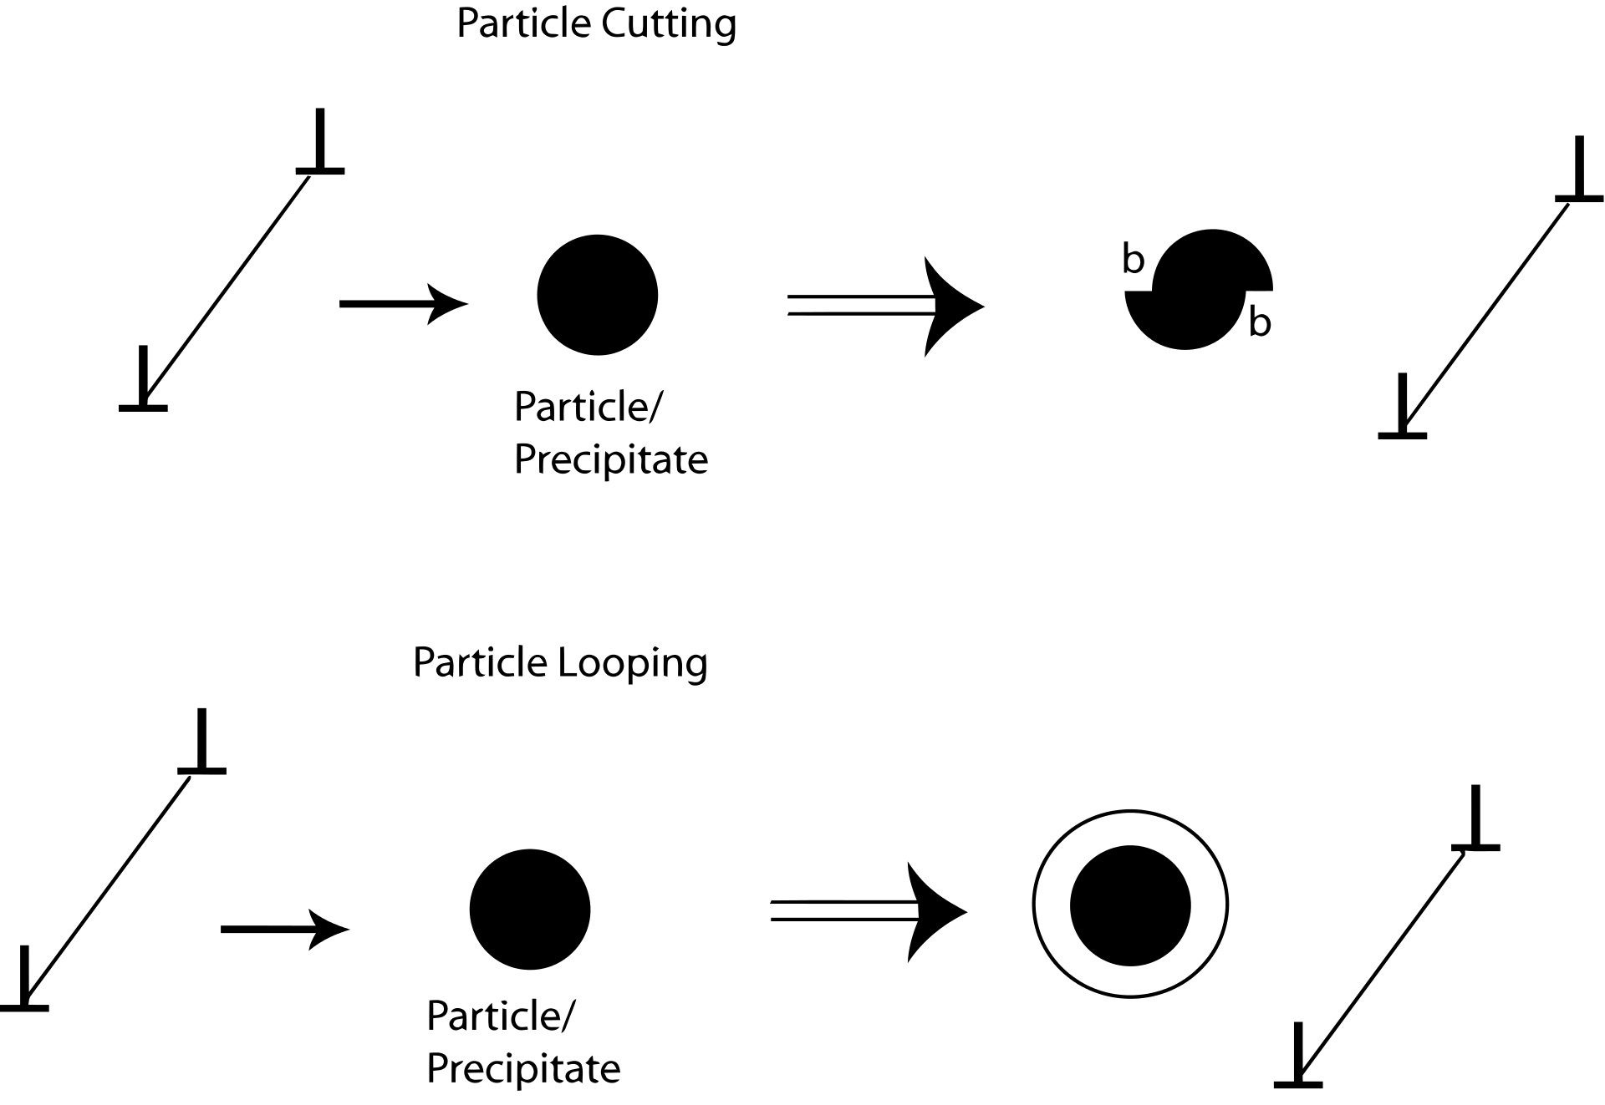
Precipitate Hardening
Precipitation hardening relies on changes in solid solubility with temperature to produce fine particles of an impurity phase, which impede the movement of dislocations
Since dislocations are often the dominant carriers of plasticity, this serves to harden the material

Slide 20
Irradiation Hardening
Cr rich, bcc alpha’ precipitates form in the higher chromium steel during thermal exposure and irradiation lead to hardening and embrittlement of the steel
Delta ferrite can promote the formation of alpha’ precipitates
Fe2Mo type precipitates have also been observed to form in HT9 and T91
The σ phase (Fe–Cr phase, enriched in Si, Ni, and P) has been observed to form around the M23C6 particles in 9–13% Cr martensitic steels after irradiation
σ phase formation is considered to be caused by radiation induced segregation

Slide 21
Irradiation Creep Resistance
Irradiation creep resistance needs a good combination of thermal creep behavior and long-term microstructural stability at high temperature
In order to fabricate creep resistant steels, you design to have a number of microstructural features that are present
Introduce high dislocation density to increase the strength of the basic lattice
Strengthen the host lattice by solid solution strengtheners or defects
Stabilize the boundaries created by phase transformations by precipitating carbides along the boundaries

Slide 22
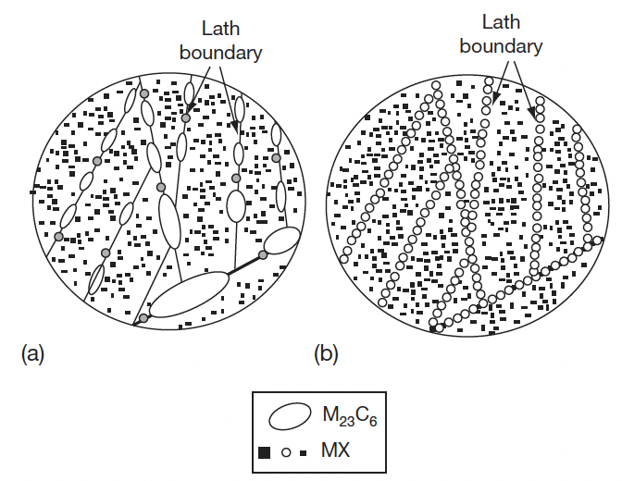
Irradiation Creep Resistance
Arrest dislocation glide and climb by selection of crystal structure, solid solution, interfaces, dislocation interactions
Resist sliding of grain boundaries by introducing special types of boundaries and anchoring the boundaries with precipitates
Ensure long-term stability of the microstructure, especially against recovery and coarsening of the fine second phase particles
In the case of 9–12 Cr steels, the martensitic lath structure decorated with only MX which should be stable over long-term service life is the most desired structure
undesirable
desirable

Slide 23
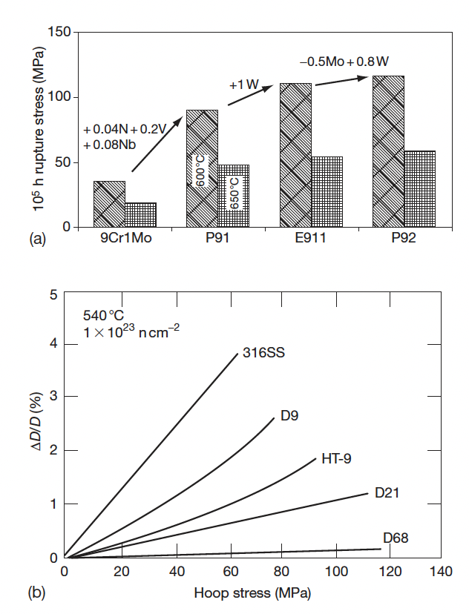
Irradiation Creep Resistance
This microstructure can only be obtained with very low amounts of C, and we need high amounts of C to have appropriate high temperature behavior
So careful tailoring of alloying elements has led to improvement of the creep strength
Thermal Creep
Irradiation Creep

Slide 24
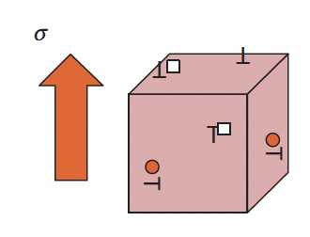
Irradiation Creep Resistance
The excess point defects precipitate into either interstitial or vacancy loops, but not randomly
The interaction between point defects and stress leads to the precipitation of interstitial loops parallel to the applied stress, while vacancy loops form in planes perpendicular to the stress
This stress-induced preferential nucleation (SIPN) results in additional creep strain solely due to irradiation

Slide 25
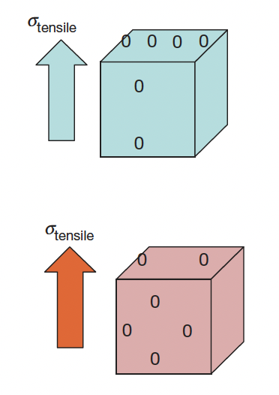
Irradiation Creep Resistance
Under applied stress, the vacancies migrate preferentially to grain boundaries perpendicular to the applied stress, while the interstitials toward boundaries parallel to the stress
This is equivalent to removing material from planes parallel to the stress to those which are perpendicular to the applied stress, introducing additional creep strain
This process is called the stress-induced preferential absorption (SIPA
Interstitial
Vacancy

Slide 26
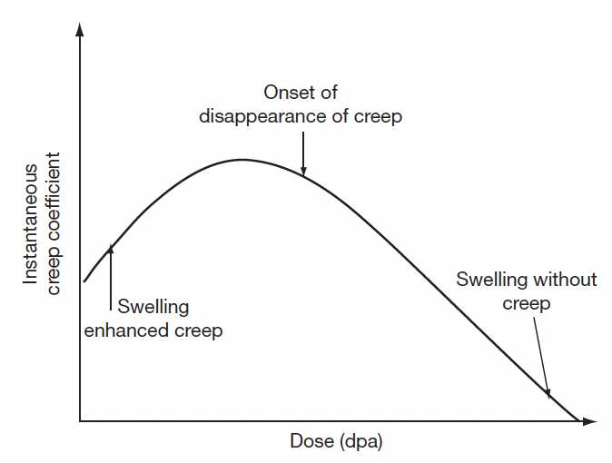
Creep Evolution
The radiation-induced defects also evolve from isolated point defect to loops and voids, which have different types of influence on irradiation creep
Irradiation creep occurs simultaneously with swelling and sometimes, swelling influences irradiation creep
At very small dose levels, swelling enhances creep rates; beyond a certain dose level the creep component reduces; at high dose levels creep disappears, while swelling continues

Slide 27
Irradiation Embrittlement
Ferritic steels have these large of monocarbides, which aid in creep resistance
The lath boundaries are decorated with Cr rich M23C6 precipitates which increase the thermal stability of the steel
Embrittlement is caused by 1) segregation of elements to lath boundaries which make the grain boundaries decohesive, and 2) evolution of carbides and intermetallic phases
For removable components such as clad, which are subjected to high temperature and pressure with a residence time of a few years, creep embrittlement is the issue which decides their design and performance
The increase in the ductile to brittle transition temperature, DBTT, is known to be related to irradiation hardening, which is generally observed to saturate with fluence

Slide 28
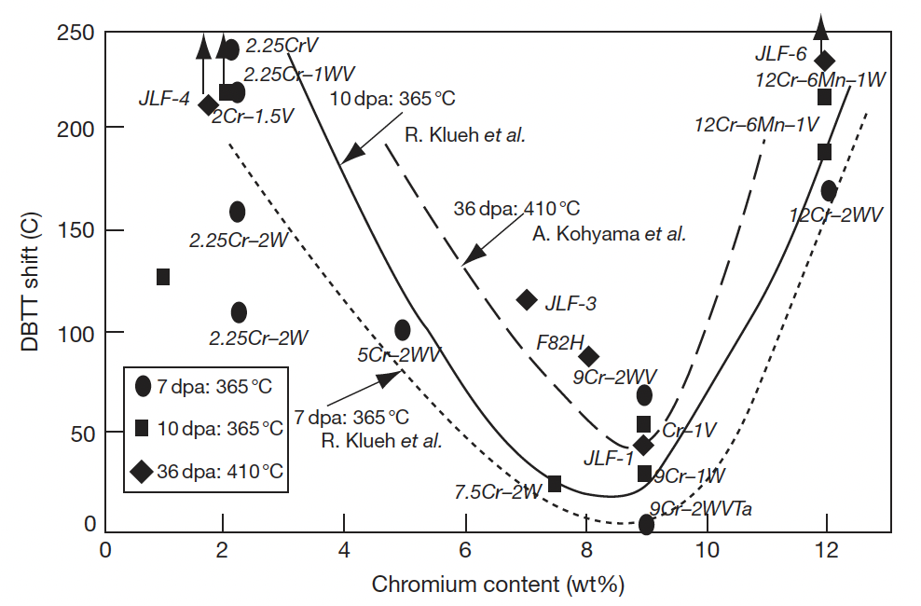
Irradiation Embrittlement
Extensive evaluation of the embrittlement behavior of the ferritic steels for different chemistry has been performed

